Slide 1
HTML5 Part II
BIT4444, Flora

Slide 2
Outline
Simple HTML forms
Input types: text, submit and reset, TextArea, password, select checkbox, radio
Form attributes: Method, action
Hidden input types
Advanced forms
Input types: color, date, date, month, week, time, range, email, number, url, search, tel,
Attributes: autofocus, placeholder, required, autocomplete
Elements: datalist
Page structure elements:
Header, time, nav, figure and figurecaption, article, summary and details, section, aside, meter, footer, mark and wbr

Slide 3
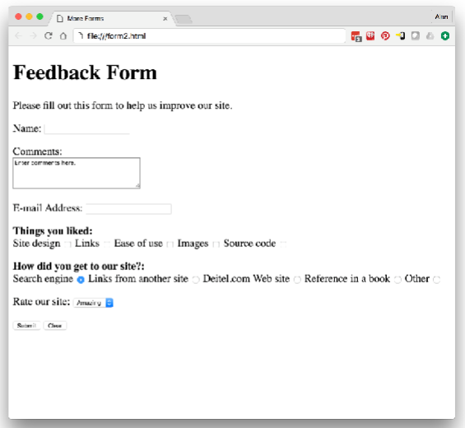
Demo 1: A simple form (form2.html)

Slide 4
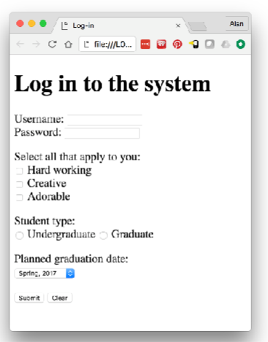
Exercise 1: loginform.html
Potential graduate dates are: Spring, 2017
Summer, 2017
Fall, 2017

Slide 5
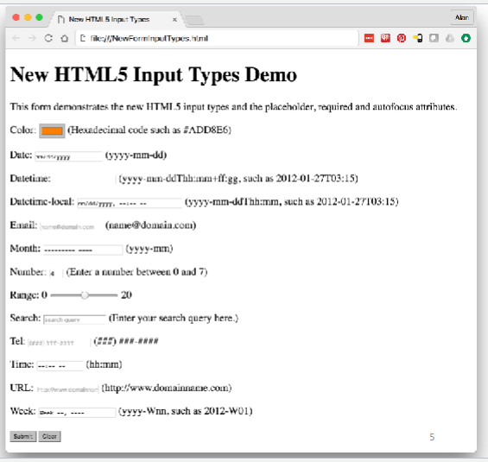
Demo 2: An advanced form (NewFormInputTypes.html)

Slide 6
Page-structure elements
Header (vs. head): A page can have multiple header elements; creates a header for each sectioning element; usually includes a heading element (h1, h2, etc.)
nav: used to group navigation links
Figure and figurecaption: a figurecaption can be associated with a group of figures (img, chart, table)
Article: used to mark a standalone section, e.g., news article, story, comment
Summary and details: summary element displays a right-pointing arrow next to a summary; when the summary is clicked, the arrow points downward and show the details element
Section: used to define a group of related content; use a heading (h1-h6) to define each section

Slide 7
Demo 3: Page-Structure Element
Read this: "How to use the HTML5 Sectioning Elements" (http://blog.teamtreehouse.com/use-html5-sectioning-elements)
Demo 3: Textbook Example Figure 3.18

Slide 8
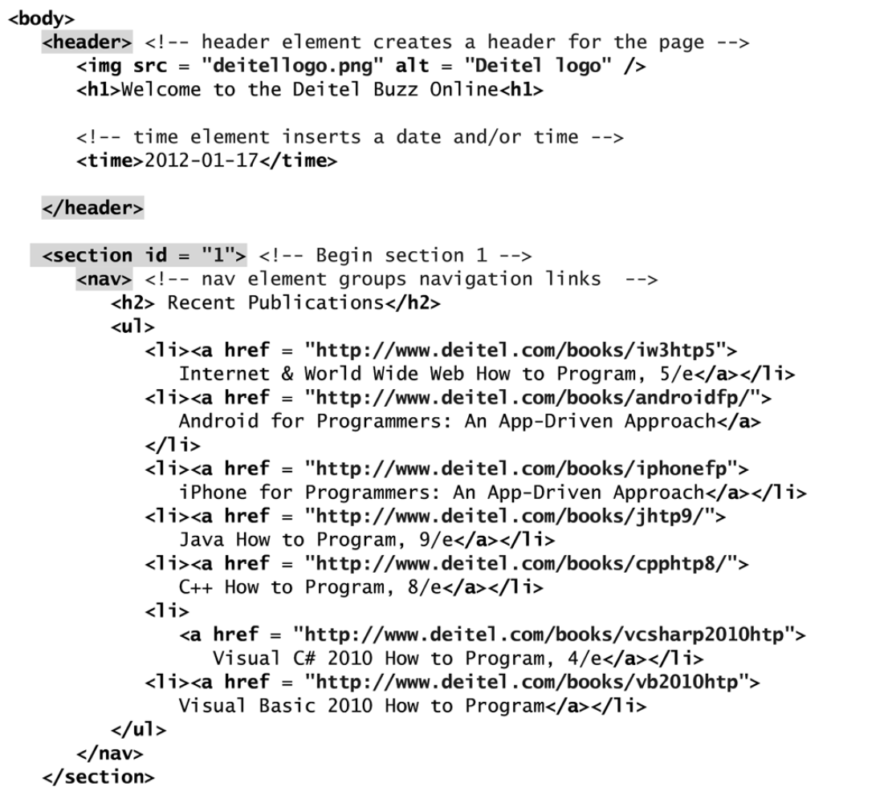

Slide 9
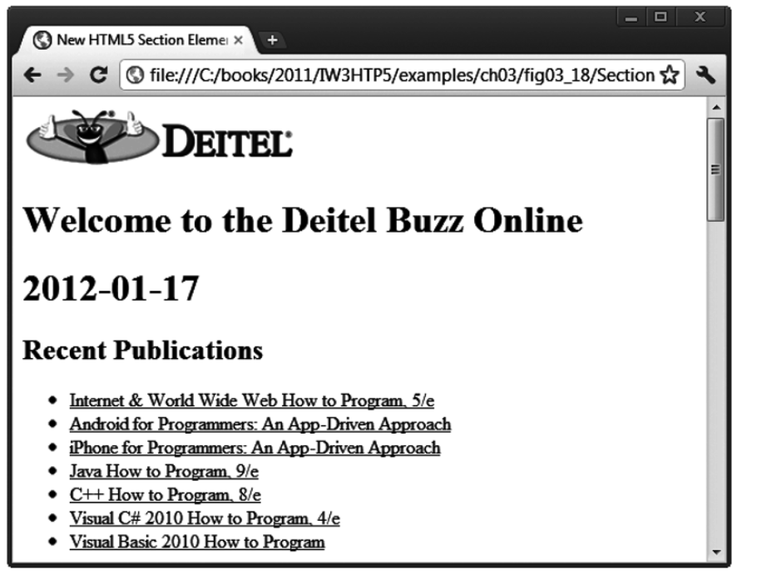

Slide 10
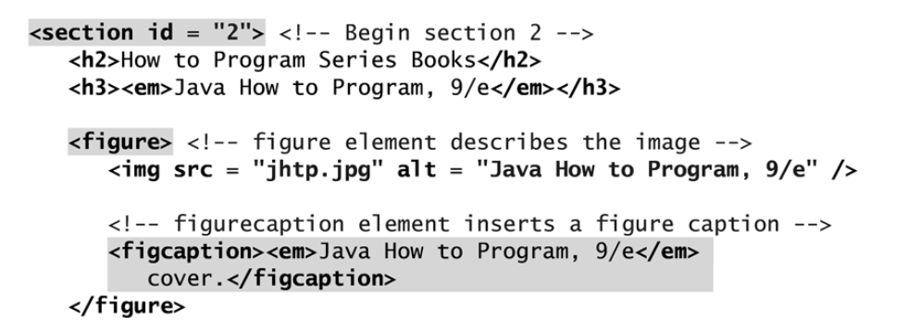
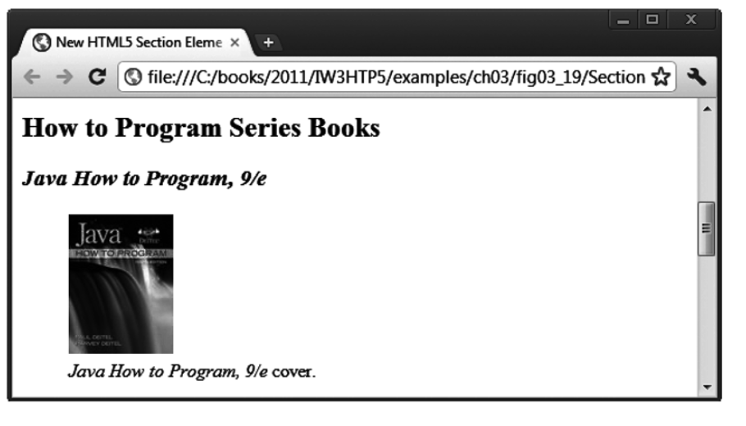

Slide 11
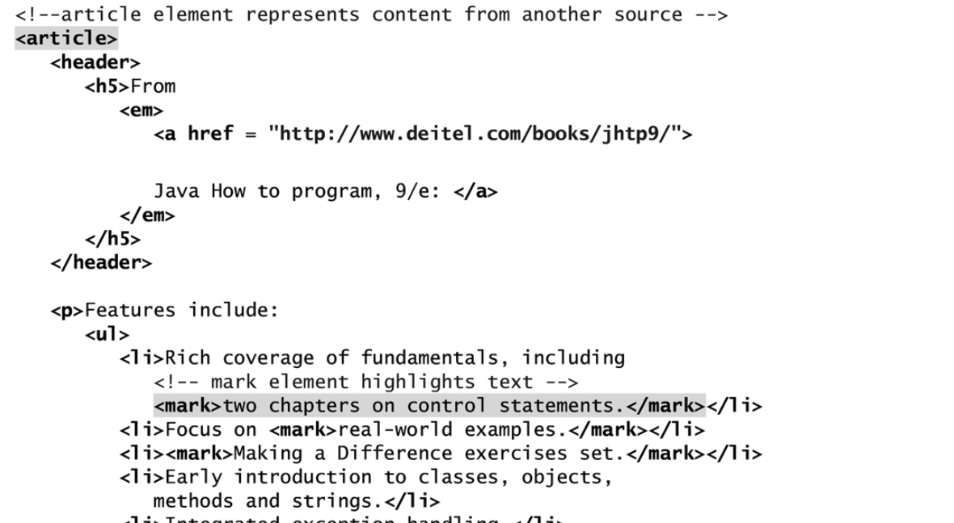
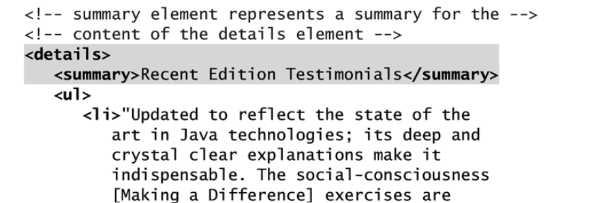

Slide 12
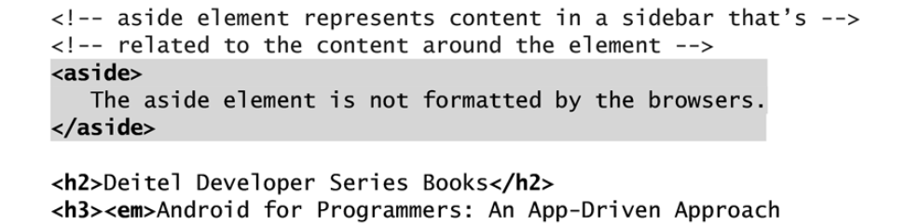
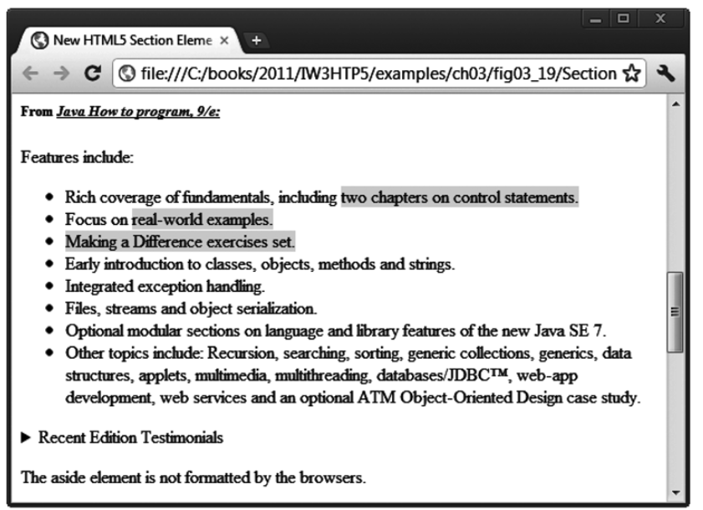

Slide 13
